Slide 1

Vehicle Dynamic Modeling
コース１Module 4

Slide 2



Generally, vehicle motion can be modeled either
by considering the geometric（幾何学的な） constraint that defines its motion（Kinematic Modeling, especially at low speeds when the accelerations are not significant） or
by considering all of the forces and moments acting on a vehicle（Dynamic Modeling）.
•
•
•
•
•
•
•
kinematic:運動学
アクチュエータのモデリング
Slip:滑り
タイヤのモデリング

Slide 3


Slide 4

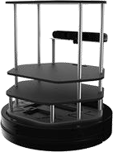
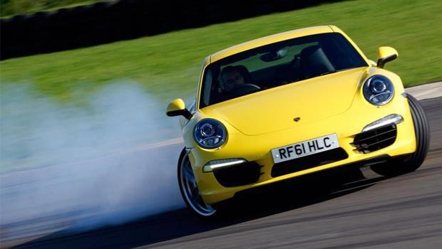
•
o
•
低速の場合、運動学モデルのみで十分
Dynamic modeling is more involved(入り組んだ), but captures
Vehicle behavior more precisely over a wide
o
𝑣 𝛿
𝑥_{𝑟}, 𝑦_{𝑟}
𝜃
𝑣
𝐿

Slide 5

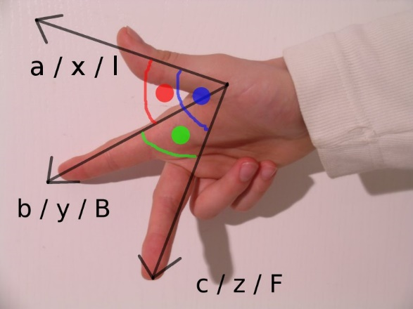


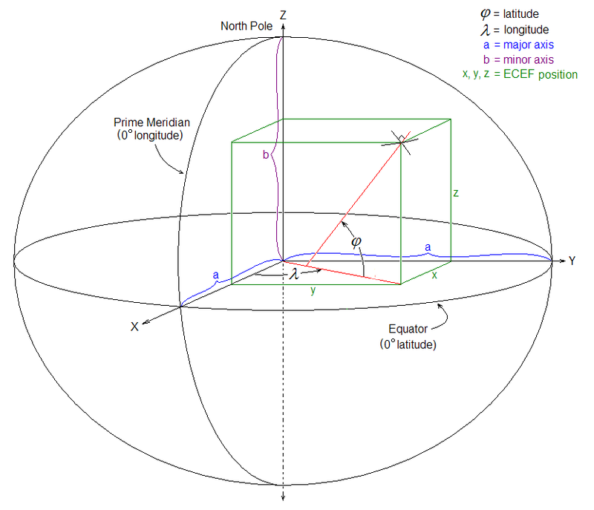


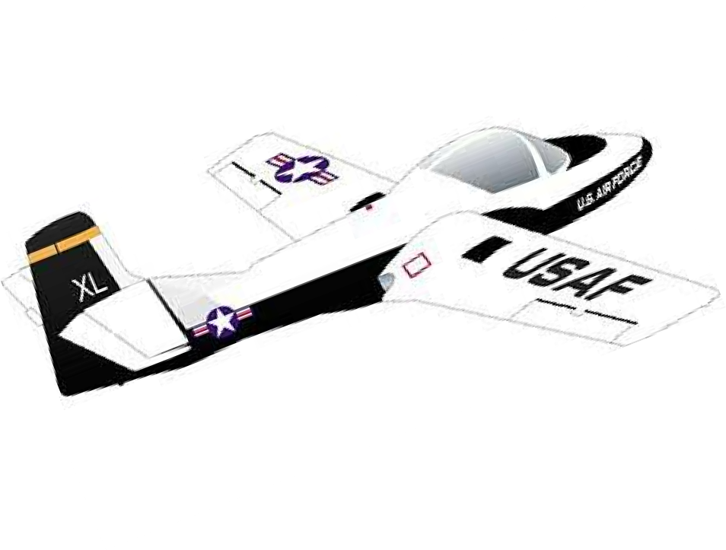
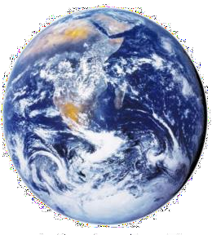
右手の法則（親指、人差し指、中指の順でx, y, z軸）
•
•
o
•
o
•
o
Right handed by convention
（global world coordinate frame ）
East North Up, ENU,
Earth-Centered Earth Fixed, ECEF (GNSS).
Attached to vehicle, origin at vehicle center of gravity, or center of rotation. (or the center point of the rear axle)
This frame is moving and rotating with respect to the fixed inertial frame as the vehicle moves about.
Y
x
x
X
y
z
z
Z
y

Slide 6
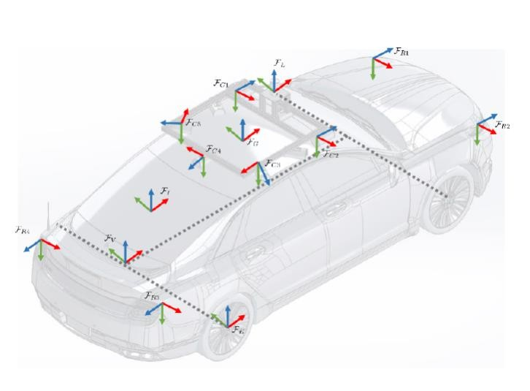
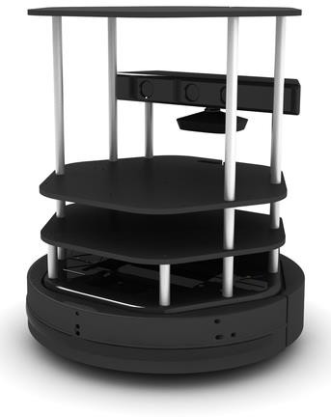

K B
T_{I} T_{K}
B
_{Y} B
T_{I}
X
I
Z

Slide 7







𝑒₂
•
𝑣
•
𝑣
𝑏₂
•
𝑏₁, 𝑏₂
𝑒₁, 𝑒₂
𝐹_{𝐵}
𝑏₁
𝑒₁
𝐹
𝐹
𝐹
𝐵
𝐸
𝐸

Slide 8



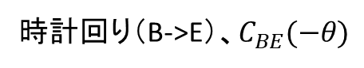
時計回り（B->E）、$C_{BE}(−θ)$
反時計回り（E->B）
cos 𝜃
−sin 𝜃
sin 𝜃 cos 𝜃
cos 𝜃 sin 𝜃
−sin 𝜃 cos 𝜃
𝐶_{𝐸𝐵} =
𝐶_{𝐵𝐸} =
𝑒₂
𝑏₂
反時計回りを正とする
𝑏₁
𝜃
𝑒
1

Slide 9











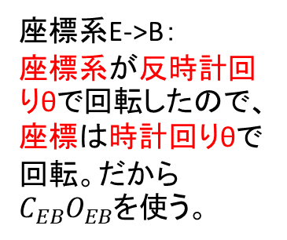
座標系E->B：
座標系が反時計回りθで回転したので、座標は時計回りθで回転。だから$C_{EB}O_{EB}$を使う。
•
P
e₂
b₂
F_{B}
b₁
𝜃
o
𝑦
𝑃_{𝐵} = 𝐶_{𝐸𝐵}
𝜃 𝑃_{𝐸} + 𝑂_{𝐸𝐵}
^{O}BE
o
F_{E}
𝑥
e₁
𝑃_{𝐸} = 𝐶_{𝐵𝐸}
𝜃 𝑃_{𝐵} + 𝑂_{𝐵𝐸}

Slide 10


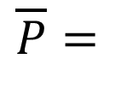
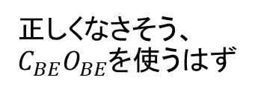
•
Homogeneous:同質
𝑥
𝑦 1
𝑥
𝑦
𝑃 =
$$\overline{P}=$$
•
𝑃_{𝐸} =
𝐶_{𝐸𝐵}(𝜃)
| 𝑂_{𝐸𝐵} 𝑃_{𝐵}
正しくなさそう、$C_{BE}O_{BE}$を使うはず

Slide 11





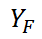
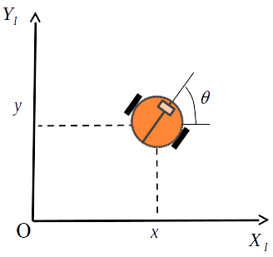




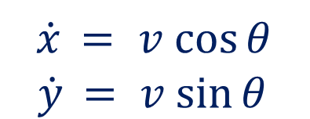
非ホロノミック：系の拘束条件の性質を述べる。
拘束条件が速度を含み、時間に対して積分できない時「運動学的な」非ホロノミック拘束。
http://www.iis.u-tokyo.ac.jp/~suzukitk/research-nh-j.html
(restrict the rate of change of the position of our robot, so robot can roll forward and turn while rolling, but cannot move sideways directly. 直接に横移動できない)
•
o o
𝑑𝑦
sin 𝜃
= tan 𝜃 =
つまり速度の向きは、ロボットの向きに制限されていると思う。
𝑑𝑥
cos 𝜃
•
𝑦
$$\dot{y}cos⁡θ −\dot{x}sin⁡ θ = 0$$
𝑥
•
$$\dot{x} = v cos⁡θ$$
$$\dot{y} = v sin⁡θ$$

Slide 12


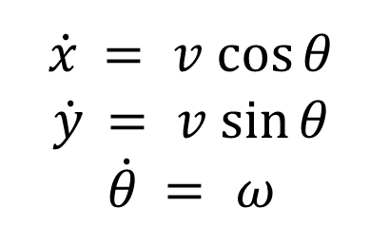
Inputs
Simple Model
States (Outputs)
𝑣, 𝜔
$$\dot{x} = v cos⁡θ$$
$$\dot{y} = v sin⁡θ$$
$$\dot{θ} = ω$$
𝑥, 𝑦, 𝜃
yaw角

Slide 13











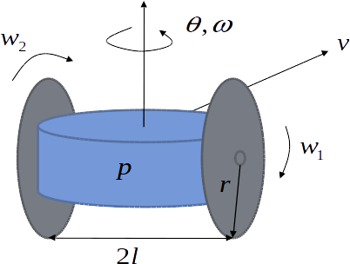
o o o o
•
Inputは両輪速度

Slide 14


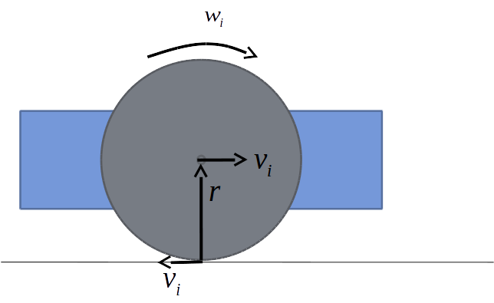
𝑣_{𝑖} = 𝑟𝑤_{𝑖}
•

Slide 15



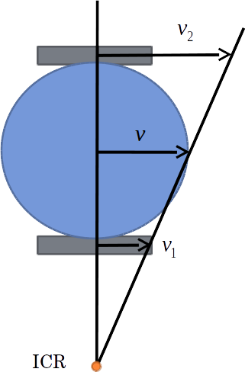
𝑣₁ + 𝑣₂ 𝑟𝑤₁ + 𝑟𝑤₂
𝑣 = =
●
2 2
瞬間中心（instant centre of rotation）：回転運動している剛体を仮想的に延長していったとき、速度ベクトルがゼロになる点として定義される。

Slide 16





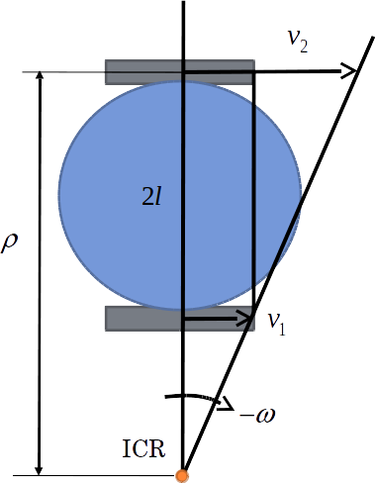
●
●
_{𝜔 =} −𝑣₂ ₌ −(𝑣₂ − 𝑣₁)
𝜌 2𝑙
𝑟𝑤₁ − 𝑟𝑤₂
𝜔 =
2𝑙

Slide 17



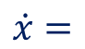
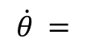
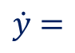
•
𝑟𝑤₁ + 𝑟𝑤₂
$$\dot{x}=$$
cos 𝜃
2
𝑟𝑤₁ + 𝑟𝑤₂
$$\dot{y}=$$
2
𝑟𝑤₁ − 𝑟𝑤₂
sin 𝜃
$$\dot{θ} =$$
2𝑙
•
^{𝑟𝑤}1,𝑘 ^{+ 𝑟𝑤}2,𝑘
𝑥
𝑘+1
= 𝑥 +
cos 𝜃 ∆𝑡
𝑘
2
^{𝑟𝑤}1,𝑘^{+𝑟𝑤}2,𝑘
𝑘
𝑦 = 𝑦 +
sin 𝜃 ∆𝑡
𝑘+1
𝑘
2
𝑘
^{𝑟𝑤}1,𝑘 ^{− 𝑟𝑤}2,𝑘
𝜃 = 𝜃 +
∆𝑡
𝑘+1
𝑘
2𝑙

Slide 18





•
•
•

Slide 19








Slide 20





kinematic bicycle model: a classic model that does surprisingly well at capturing vehicle motion in normal driving conditions.
•
•
When the desired point is at the center of front axle (𝑥_{𝑓}, 𝑦_{𝑓})
3点の移動軌跡が違うので、数式も違うと思う
When the desired point is at the
center of rear axle (𝑥_{𝑟}, 𝑦_{𝑟})
Y
front tire
cg
rear tire
F_{I}
X
When the desired point is at the center of gravity (𝑥_{𝑐}, 𝑦_{𝑐})

Slide 21




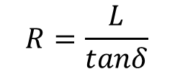
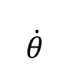
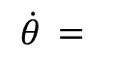
Robot modelの上、更にsteering angle for the front wheelを定義する（δ）
measured relative to the forward direction of the bicycle
no slip condition: wheel cannot move laterally or slip longitudinally
•
o
自分の理解：
この図から考えると、前輪中心と後輪中心のωが同じで、速度大きさが違うと見える。
前後輪の半径が長い（操舵角が小さい時）場合、前後輪の速度もほぼ同じでしょう。
δが0の場合、半径が無限大、前後輪の速度が一緒。
𝜔 = ^{𝑣}
$$\dot{θ} =$$
ICR
𝑅
𝛿
o
𝐿
tan 𝛿 =
𝑅
𝜔
𝑣
𝛿
𝜃
$$R=\frac{L}{tanδ}$$
o
𝑣
𝐿
_{= 𝜔 =} 𝑣 ₌ 𝑣 tan 𝛿
𝑅 𝐿
$$\dot{θ}$$

Slide 22



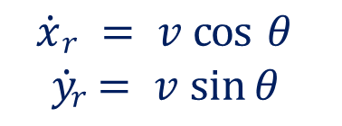
•
$$\dot{x}r = v cos⁡ θ$$
$$\dot{y}r = v sin⁡θ$$
𝑣
𝛿
𝑣 tan 𝛿
𝜃
$$\dot{θ} =$$
𝑥_{𝑟}, 𝑦_{𝑟}
𝐿
𝑣
𝐿

Slide 23

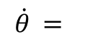
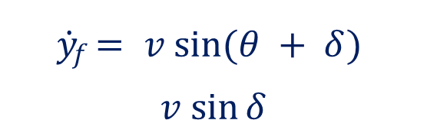

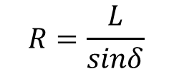
•
𝑥_{𝑓}, 𝑦_{𝑓}
𝑣
$$\dot{x}f$$
= 𝑣 cos(𝜃 + 𝛿)
𝛿
𝜃
$$\dot{y}f = v sin⁡(θ + δ)$$
$$v sin⁡δ$$
$$\dot{θ} =$$
𝑣
𝐿
ICR
𝐿
𝛿
𝜔
$$R=\frac{L}{sinδ}$$
𝑣
𝛿
𝜃
𝑣
𝐿

Slide 24

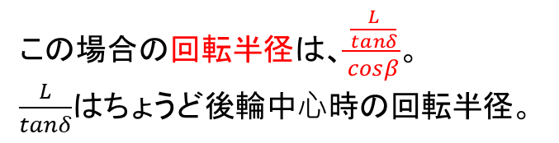
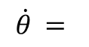
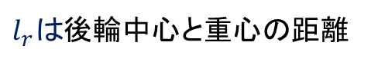

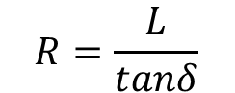
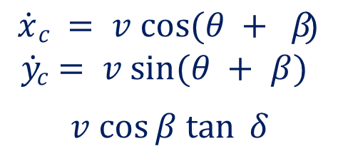
•
β: slip angle
use as the basis of modeling of the dynamics of vehicles
ICR
$$\dot{x}c = v cos⁡(θ + β)$$
$$\dot{y}c = v sin⁡(θ + β)$$
$$v cos⁡β tan⁡ δ$$
𝛿
𝜔
𝑣
𝛿
𝑥_{𝑐}, 𝑦_{𝑐}
𝜃
𝑣 _{𝛽}
$$\dot{θ} =$$
$$R=\frac{L}{tanδ}$$
𝐿
cg
$l_{r}$ tan 𝛿
𝑣
𝐿
𝛽 = tan⁻¹
𝑟
𝐿
この場合の回転半径は、$\frac{\frac{L}{tanδ}}{cosβ}$。
$\frac{L}{tanδ}$はちょうど後輪中⼼時の回転半径。
$l_{r}は$後輪中心と重心の距離

Slide 25





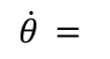
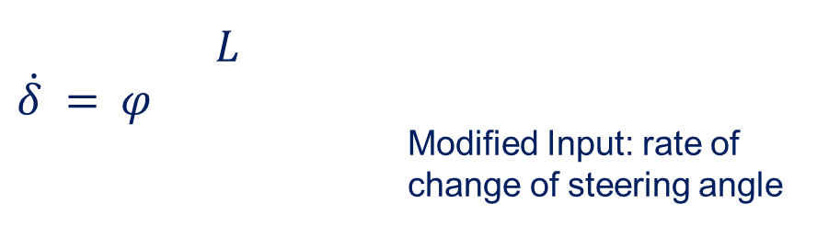
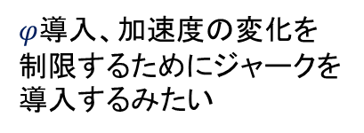
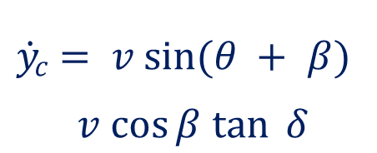
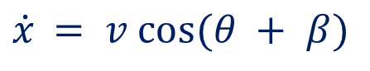
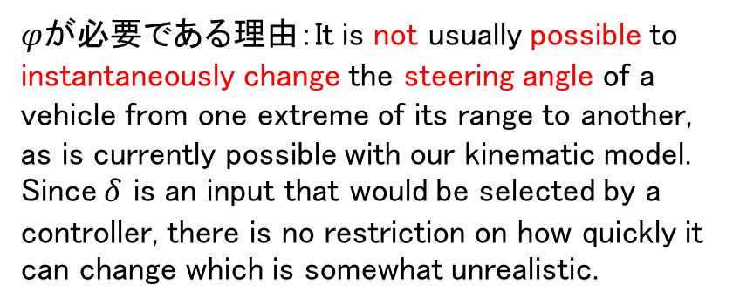
•
o
𝑥, 𝑦, 𝜃, 𝛿 ^{𝑇}
𝑣, 𝜑
𝑇
𝑣
𝛿
𝑥_{𝑐}, 𝑦_{𝑐}
𝜃
$$\dot{x} = v cos⁡(θ + β)$$
𝑣 _{𝛽}
𝑐
$$\dot{y}c = v sin⁡(θ + β)$$
$$v cos⁡β tan⁡ δ$$
cg
𝑣
𝐿
$φ$が必要である理由：It is not usually possible to instantaneously change the steering angle of a vehicle from one extreme of its range to another, as is currently possible with our kinematic model. Since $δ$ is an input that would be selected by a controller, there is no restriction on how quickly it can change which is somewhat unrealistic.
$$\dot{θ} =$$
𝐿
$$\dot{δ} = φ$$
Modified Input: rate of
change of steering angle
$φ$導入、加速度の変化を制限するためにジャークを導入するみたい

Slide 26




•
o o

Slide 27



Slide 28



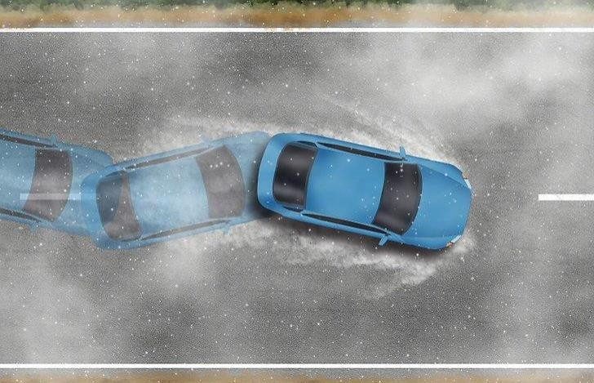
Start taking into account the forces and moments acting on the vehicle 強み：can lead to higher fidelity（忠実）predictions, than are possible with kinematic models
•
o
o
Many sub systemsにもkinematic constraintが適⽤できない。例えばdrive train: the balance of torques is needed to capture the connection from throttle（スロットル） position to wheel torque through the engine and transmission systems.
滑りやすい道

Slide 29
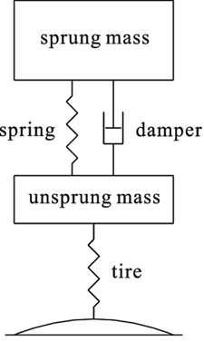
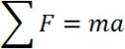
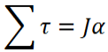




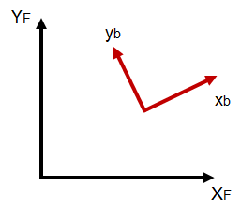


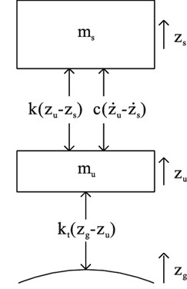


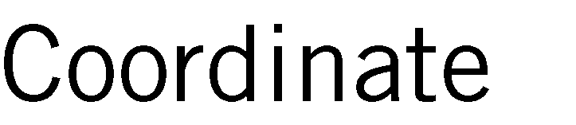


set up coordinate frames
break down dynamic system into lumped dynamic elements 1. 例えばspring mass damper: lumped elementsはthe spring, the mass, the damper
define a model for each lumped element - 例えば、the linear spring
sketch the free body diagram for each rigid body in the list of elements
Dynamic equations: Newton’s second law（運動の第2法則）
•
質量
角加速度
ばね
ダンパー
慣性
自由体ダイアグラム

Slide 30


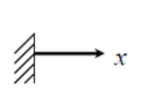
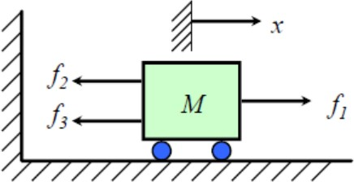


•
•
•
$$Ma =∑ F$$
$$M\ddot{x} = f1 − f2 − f3$$
カート

Slide 31


























サスペンション
- The shock absorber（ショックアブソーバー） relies on its spring and hydraulics cylinder （油圧シリンダ）with flow restriction to absorb shocks. - use a linear spring and damper model: spring resist displacement in y and damper resist the y velocity.
（下に減速）
Spring constant
減衰
Damping coefficient

Slide 32













使われる場合：combustion engine（内燃機関） shafts（シャフト、軸）, gear boxes, torque converters（トルクコンバーター） and tires.
•
•
•
o o o
ねじり力
つまりドライブトレイン全般に使われている
減衰力

Slide 33




$$J\ddot{θ} + b\dot{θ} + kθ = τDrive − τLoad$$
$$θ, \dot{θ} , \ddot{θ}$$
^{𝜏}𝐷𝑟𝑖𝑣𝑒
The tire model has rotational inertia J due to its rotating mass.
Torsional stiffness（剛性、ごうせい） k and damping b, defined by the material properties of the tire in the wheel hub（車輪ボス）.
We drive the wheel with a drive torque（駆動トルク） from the vehicle’s drive shaft（ドライブシャフト）and resist this with a load torque（負荷トルク） coming from the tires interaction with the road’s surface. Driveトルクはシャフトを駆動する、Loadトルク（路面）は抵抗する。
𝜃
J
^{𝜏}𝐿𝑜𝑎𝑑
k b

Slide 34




Dynamic modelの応⽤
used to improve state estimation methods when fusing sensor data to track motion
used to aid in controller design to track a desired trajectory or path （縦制御、横制御に全部使っている）
help self-driving engineers define the limits of vehicle performance to avoid from planning unsafe trajectories that a car cannot track.
•
o o
法線力
ドライブトレイン
https://projectchrono.org/

Slide 35


空気力学、りきがく
牽引力
Z
勾配
転がり抵抗
傾いた、かたむいた
X

Slide 36



centrifugal force（遠⼼⼒）
Y
X

Slide 37
•
o
Vehicle Modeling: Vehicle Dynamics (2016) http://publications.lib.chalmers.se/records/fulltext/244369/244369.pdf

Slide 38


Slide 39














^{𝐹}𝑎𝑒𝑟𝑜
𝑚𝑥
^{𝐹}𝑥𝑓
^{𝐹}𝑥𝑟
^{𝑅}𝑥𝑓
𝑚𝑔 sin 𝛼
𝛼
^{𝑅}𝑥𝑟
傾斜、けいしゃ
$$m\ddot{x} = Fxf + Fxr − Faero − Rxf − Rxr − mg sin⁡α$$

Slide 40











$$m\ddot{x} = Fxf + Fxr − Faero − Rxf − Rxr − mg sin⁡α$$
•
𝐹_{𝑥} |  | 𝐹_{𝑥} = 𝐹_{𝑥𝑓} + 𝐹_{𝑥𝑟}
𝑅_{𝑥} • | 𝛼 | 𝑅_{𝑥} = 𝑅_{𝑥𝑓} + 𝑅_{𝑥𝑟} sin 𝛼 = 𝛼
•
$m\ddot{x}$ = 𝐹_{𝑥} − 𝐹_{𝑎𝑒𝑟𝑜} − 𝑅_{𝑥} − 𝑚𝑔𝛼
Inertial Term
Traction Force
Total Resistant Forces (𝐹_{𝐿𝑜𝑎𝑑})
（generated by power train）

Slide 41





𝐹_{𝑙𝑜𝑎𝑑} = 𝐹_{𝑎𝑒𝑟𝑜} + 𝑅_{𝑥} + 𝑚𝑔𝛼
•
•
またthe vehicle’s coefficient of friction
正面面積
$$Faero = \frac{1}{2} CaρA\dot{x}2 =c_{a}\dot{x}2$$
•
垂直抗力
$$Rx = N(\hat{c}r,0 + \hat{c}r ,1 \dot{x}$$
$$+ \hat{c}r ,2\dot{x}2) ≈ cr,1 \dot{x}$$

Slide 42





























パワートレイン、伝動（でんどう）機構
クラッチ（英: Clutch）は、2つの動力伝達軸の間で回転を伝達したり遮断したりする機械要素である
𝜔_{𝑤}
𝜔_{𝑒}
Torque Converter 参考：How Torque Converters Work! https://www.youtube.com/watch?v=z5G2zQ_3xTc
差動装置（差動歯車）
クラッチ
$$\dot{x} = reffωw$$
. . . (2)
$\dot{x}$ :
^{𝑟}𝑒𝑓𝑓 :
𝜔 = $GRω_{t}$= 𝐺𝑅𝜔
クラッチが伝達する場合
𝑤
𝑡
𝑒
(including the torque converter, transmission, differential)
𝜔_{𝑤} :
𝜔_{𝑡} :
𝜔_{𝑒} :
𝐺𝑅
タービン:流体がもっているエネルギーを有用な機械的動力に変換する回転式の原動機の総称
$$\ddot{x} = reffGR\dot{ω} e$$

Slide 43









The wheel is the intersection between the torques coming from the power train side, and the torques acting from the external resistance forces.
トルクのGR関係や角速度のGR関係は逆。パワー$P=τω$から。
𝜔_{𝑤}
^{𝑇}𝑤ℎ𝑒𝑒𝑙
$T_{wheel}$: actually the combination of the brake torque and the output torque of the transmission or gearbox
$T_{t}$: the torque applied to the transmission. still includes a dependence on the tire force $F_{x}$.
𝜔_{𝑡}
𝑇_{𝑡}
(When Coupled, 連動した)
P42 Rotational Coupling式を利用
$ω_{w}$= $GRω_{t}$= $GRω_{e}$
𝜔
^{𝑇}𝐸𝑛𝑔𝑖𝑛𝑒
𝑒

Slide 44





$$Fx = m\ddot{x} + Fload = mreffGR\dot{ω}e + Fload$$
•
P42, Longitudinal acceleration式を利用
$$\ddot{x} = reffGR\dot{ω} e$$
•
上記式を利用して、p43 Engine式内の$F_{x}を$取り換えている。
•
We do still need to relate the engine torque to the accelerator pedal（ペダル） position, and the brake torque to the brake pedal position, which in the video on Actuator Modeling.
C1M5 p22 Lower Level Controllerがこの式を利用し、Desired accelerationからEngine torqueを計算する。またEngine mapを利用し、Engine torqueと現在Engine RPMからThrottle Angleを決める。

Slide 45

•
•
•

Slide 46


Slide 47




extend our kinematic bicycle model to a dynamic model by relaxing the no slip condition and force for the kinematic model.
•
o o
o
⽬的：to decouple（切り離す） lateral and longitudinal dynamic models. but does lead to modeling inaccuracies when accelerating or decelerating out of curves.
サスペンション移動、道路勾配、空気力学影響考えず

Slide 48






















use the vehicle center of gravity as the reference point.
$a_{y}$: the total acceleration in the inertial frame.
$\ddot{y}$: the lateral acceleration in the body frame.
$ω^{2}R$: the centripetal（求心） acceleration from rotation of the vehicle （車の回転によってyaw角が変わる、車の重心はyaw axisだと思う）
•
横移動加速度＋回転による求心加速度
𝑉 _{𝛿}
僕$の考え：v_{y}=Vsinβ≈Vβ、Vは$定数（前ページ）
𝛽
回転の部分
$$\dot{ψ}$$
_{𝑙𝑓}
^{𝐹}𝑦𝑓
𝑙_{𝑟}
^{𝐹}𝑦𝑟

Slide 49








Tire forces are generally hard to predict exactly, and tire models tend to be nonlinear and empirically（経験的に） identified.
•
•
•
As we use the linear tire model in our control design, we must make sure to not exceed this small angle assumption by sticking to non-aggressive driving maneuvers.
typically less than 8 degrees.
o o
𝛼_{𝑓}
𝛼_{𝑟}
𝛼_{𝑓}
𝑉
Tire slip angleは車輪の向きと車輪の実際の運動方向の差。p72
cg
𝛽
$$\dot{ψ}$$
𝑙_{𝑓}
^{𝐹}𝑦𝑓
𝑙_{𝑟}
^{𝐹}𝑦𝑟
^{𝐹}𝑦𝑟

Slide 50




cornering stiffness of a tire : the ability to resist deformation（変形） while the vehicle corners.
Cornering stiffness
𝐶_{𝑓} :
なぜfront tire slip angleやrear tire slip angleがこの式になっているかはまだ分かっていない
𝐶_{𝑟} :

Slide 51




(linear because of assumptions)
•
Substitute the lateral forces
Rearranging the equations

Slide 52




$A_{lat} B_{lat}$ are time-invariant if the forward speed V is kept constant.
The main input to the system is the driver steering angle command, $δ$.
This state space representation is very useful when we are designing different control strategies such as PID or MPC for lateral control. PID/MPC横制御は後で紹介する。
The linearity of this model also makes it suitable for state estimation with Kalman filters.
•
𝑋
= 𝑦
side slip angle
𝛽 𝜓 $\dot{ψ}$
𝑙𝑎𝑡
lateral position
yaw rate
yaw angle
0
0 −
0
0
𝑉
0
0
𝑉
𝐶_{𝑟} +𝐶_{𝑓}
0
𝐶_{𝑟}𝑙_{𝑟} −𝐶_{𝑓} 𝑙_{𝑓}
− 1
𝑚𝑉 0
𝑚𝑉²
1
^{𝐴}𝑙𝑎𝑡 ⁼
𝐶_{𝑟}𝑙_{𝑟} −𝐶_{𝑓} 𝑙_{𝑓}
𝐶 𝑙² +𝐶
_{𝑙}2
0 −
𝑟 𝑟 𝑓
𝑓
𝐼_{𝑧}
𝐼_{𝑧}𝑉
0
𝐶_{𝑓}
𝑚𝑉 0
𝐶_{𝑓}𝑙_{𝑓}
^{𝐵}𝑙𝑎𝑡 ⁼
𝐼_{𝑧}

Slide 53

•
•

Slide 54


Slide 55












the lateral dynamics and the longitudinal dynamics can affect each other.
Lesson 5: Lateral Dynamic Bicycle Modelの内容
Steering
Lateral
Yaw
Forces
Rate
Throttling
Longitudinal
Forward
Braking
Forces
Velocity
Actuation&タイヤモデル
Lesson 4: Longitudinal Vehicle Modelの内容
疑問：KinematicモデルはForceを扱わないはずなので、ここはDynamic+Kinematicだと思う。
These desired elements are provided by the motion planning system.

Slide 56










Slide 57



Steering Angle
Steering System
Wheel Angle
𝛿 = 𝑐𝛿_{𝑠}

Slide 58



steering assemblyのmain subsystem: steering wheel, steering column, steering gears and linkages that connect the steering column to the left and right wheels.
rack and pinion gears which translate the rotational motion of the steering wheel to the linear motions needed to move the wheel linkages.ラック・アンド・ピニオン：回転力を直線の動きに変換する
ハンドル
ステアリングコラム
自在継手、つぎて

Slide 59












•

Slide 60










Slide 61




𝑥_{𝜃}
𝜔_{𝑒}, 𝑇_{𝑒}
Accelerator pedal position (Throttle)

Slide 62










The characteristics of the internal combustion engine（内燃機関）, diesel engines, and electric motors（電動モーター） are all different.
The torque-speed diagram is used as a diagram to represent these characteristics for power units.
ディーゼルエンジン
放物線、ほうぶつ
横軸：エンジン回転数
The highest torque operating point for a gas engine tends to be in the middle RPMs typically 2,000 or 3,000 RPM for a passenger vehicle engine.
At low and high speeds, the ability of the engine to produce torque falls off.
show more consistent（一貫した） torque generation over a wider range of speeds.
This is why diesel engines are more suitable for heavy-duty vehicles（大型車、おおがたしゃ） and the gasoline engines are best suited for small and city cars.
more efficient at lower RPMs such as 1,500.
not very efficient at higher RPM.
to compensate the lack of torque characteristics at the higher RPM in electric motors, the hybrid electric vehicles use the internal combustion engine to improve performance over electric motors at higher speeds.

Slide 63



Given the engine speed and throttle position, it is possible to compute the engine torque produced based on this semi-empirical map, which then feeds into the longitudinal dynamics model for the vehicle.
𝑇_{𝑒}
𝜔_{𝑒} = 𝐴₀ + 𝐴₁𝜔_{𝑒} + 𝐴 𝜔²
𝑚𝑎𝑥
2 𝑒
𝑇_{𝑒} 𝜔_{𝑒}, 𝑥_{𝜃} ≈ 𝑥_{𝜃}(𝐴₀ + 𝐴₁𝜔_{𝑒} + 𝐴 𝜔²)
2 𝑒
A0, A1, A2 are identified and tuned for different engines

Slide 64











Braking System Model
brake pedal position → translated into a brake pressure by the electronic control unit (ECU).
The braking torque on the wheels creates a negative longitudinal force to decelerate the vehicle.
Because of the control unit management of the braking torque, the response to the braking system is very predictable.

Slide 65



∆𝑃
Brake Pressure
^{𝑇}𝑏𝑟𝑎𝑘𝑒
Brake Torque
𝑇_{𝑏𝑟𝑎𝑘𝑒} = 𝑘 ∆𝑃

Slide 66



•
o o o
アンチロック・ブレーキ・システム（Anti-lock Braking System）とは、急ブレーキあるいは低摩擦路でのブレーキ操作において、車輪のロックによる滑走（かっそう）発生を低減する装置である
舵（かじ）効き
ひっくり返る、転覆（てんぷく）

Slide 67

•
•
In the autonomous car, these actuation signals will be the main output of the vehicle control module.

Slide 68



Slide 69









•

Slide 70





Slip Angle : the angle between the forward direction of the vehicle and the actual direction of its motion.
Lateral Velocity
𝛽
Longitudinal Velocity

Slide 71





•
•
𝑉
𝛿
𝑉_{𝑦}
𝛽
𝑉
𝑥
𝑦
𝑥

Slide 72







●
Tire slip angle is the angle between the direction in which a wheel is pointing and the direction in which it is actually traveling.
$$lr\dot{ψ}$$
yaw rate
$$lf\dot{ψ}$$
𝛼_{𝑟} = −𝛽 +
𝛼_{𝑓} = 𝛿 − 𝛽 −
未理解
𝑉
𝑉
vehicle slip angle
forward velocity
steering angle

Slide 73




スリップ比
•
滑る、減速の場合
𝑤𝑟_{𝑒} < 𝑉
wheel angular speed
tire effective radius
スピン、加速の場合
𝑤 𝑟_{𝑒} − 𝑉
𝑠 =
𝑤𝑟_{𝑒} > 𝑉
𝑉
vehicle forward velocity
ロックされた
modern anti-lock braking systems seek to avoid this regime due to its poor stopping performance and loss of steering control.
𝑤𝑟_{𝑒} = 0

Slide 74



Inputs to the tire model
Outputs of the tire model
Tire Slip Angle
Slip Ratio
Normal Force（法線力）
Friction Coefficient
Camber Angle
Tire properties
Lateral Force
Longitudinal Force
Self-Aligning Moment （セルフアライニングトルク） Rolling Resistance Moment
Overturning Moment（転倒モーメント）
Self-Aligning Moment (the moment about the steering axis. self aligns a tire with the direction of travel. タイヤを移動方向に合わせるモーメント)
camber angle（キャンバー角） : ⾞体に取り付けられている⾞輪を正⾯から⾒たときに、⾞輪縦⽅向の中⼼線が垂直線となす⻆度をいう。

Slide 75


Aligning Moment: タイヤを移動方向に合わせるモーメント
http://www-cdr.stanford.edu/dynamic/bywire/tires.pdf
キャンバー角
https://en.wikipedia.org/wiki/Camber_angle

Slide 76















•
o o
•
o o o
•
o o o o
数の、数字で表した
difficult to use for model-based control development
Look up tables instead of mathematical equations
パチェイカ
Need experiments for each specific tire
(parameterized function)

Slide 77






•
o
The Linear tire model is a good approximation for a significant portion of the linear region, but drops in accuracy as we enter saturation（飽和）.
maximal longitudinal tire force
maximal lateral tire force
𝜷
largest slip ratio
largest slip angle

Slide 78


















パチェイカ
because of how well it represents longitudinal and lateral tire forces.
•
o
𝐹 𝑥, 𝐹_{𝑧} = 𝐷 sin 𝐶 tan⁻¹(𝐵𝑥 − 𝐸(𝐵𝑥 − tan⁻¹(𝐵𝑥))) 𝜇𝐹_{𝑧}
x
これは車の負荷と大きく関係すると思う
define system parameters B, C, D, E from experiments, and these will differ from one tire to another.

Slide 79




Slide 80





•
•
•

Slide 81


•
•
•
•

